Slide 1
Robin Mead

Slide 2
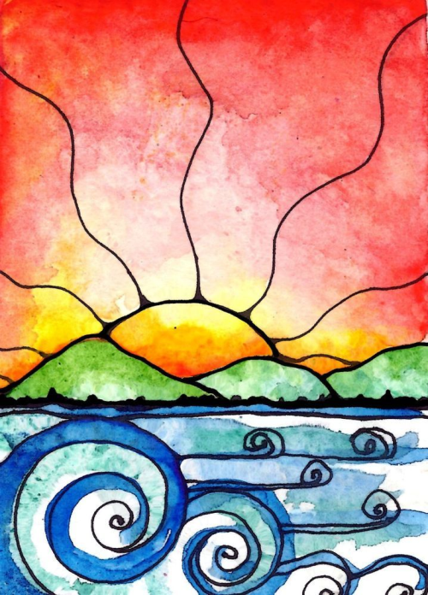
Robin Mead
Robin Mead is an independent, self -representing artist whose works include digital and altered art, acrylic and mixed media paintings and watercolor landscapes and gardens. She also creates wonderful vibrant colored crochet afghans and handmade art journals that infuse her love of color into joyful creations that can be used in the home or given as gifts.
Robin combines her background in the Social Work profession with her love of expressing joy by creating colorful depictions of nature, preferably the ocean, landscapes, flowers and birds. She relies on her intuitive skills and insight to capture the ‘joy’ that she feels, and translate it onto paper, canvas and the digital screen. After attending art school on Long Island, New York in 2003, she began sharing her work in local shows and on the internet by way of websites, blogs and online shops. Robins work can be found in homes around the world as well as album covers, books, and in tutorials for creating art.
In 2013 Robin and her family decided to downsize… so they left New York and moved to a small town in Northeast Georgia. She left her full time position as a social worker, bought a few small houses and a bunch of acres and her family now resides on a small farm-like property with chickens, beautiful landscape and the most wonderful neighbors. Robin loves to spend time at the ocean or in nature looking for inspiration, and always have a bag of art supplies ready in hand.. She lives with her husband Wilson of 28 years 2 daughters Victoria and Rachel, son in law Alex, his parents and friends enjoying their time in the deep south.
My Web Page: http://robinmeaddesigns.com
My Blog: http://insightsandbellylaughs.com

Slide 5
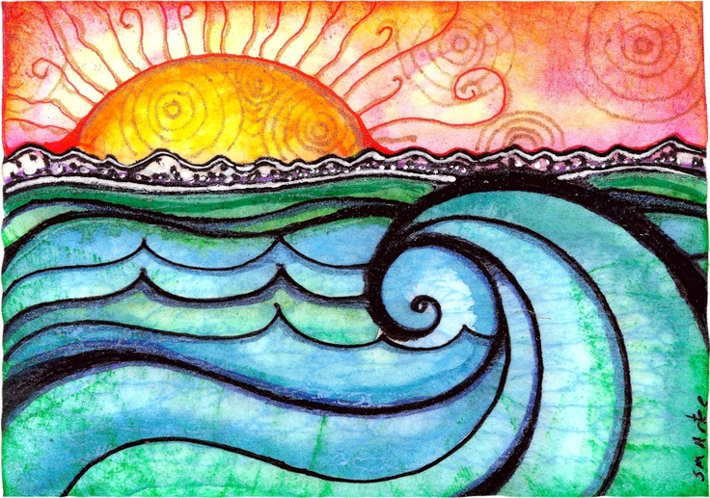

Slide 7
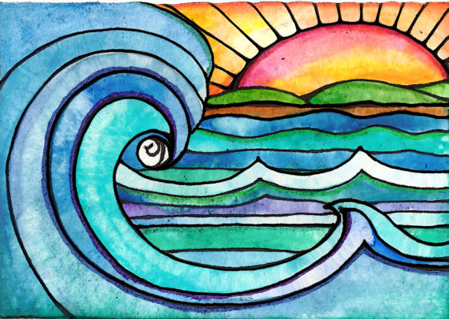
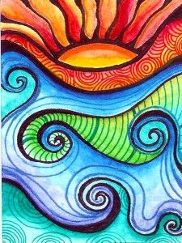
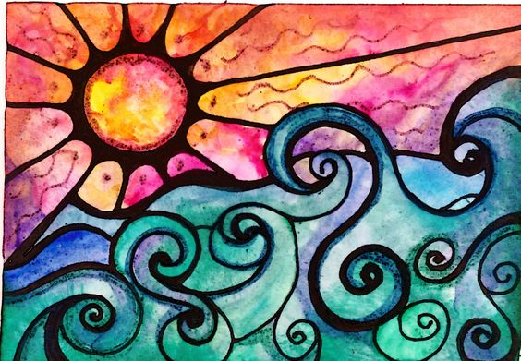
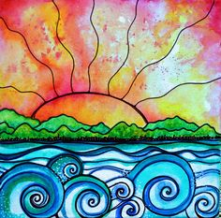

Slide 9
YouTube Videos:
https://www.youtube.com/watch?v=B3dkrRFhGQs&t=0s&index=9&list=PL2_a0MPATnBGaSoeF2bhfUlUNFbwYa_Ob
https://www.youtube.com/watch?v=yyhSGdEGQRY&t=0s&index=10&list=PL2_a0MPATnBGaSoeF2bhfUlUNFbwYa_Ob
https://www.youtube.com/watch?v=tglpgbBoYjI&t=0s&index=11&list=PL2_a0MPATnBGaSoeF2bhfUlUNFbwYa_Ob

Slide 10
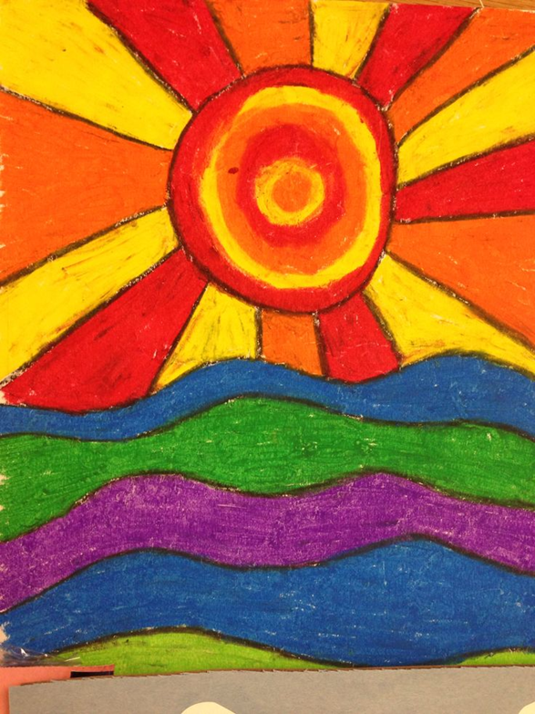
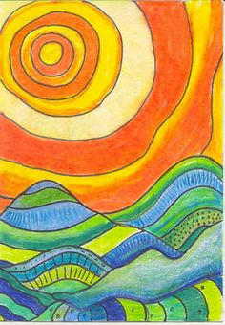
Student Art

Slide 11
